Slide 1
All About My Project Idea
Parthiban J | Faceprep ID : 1509930

Slide 2
Insurance System

Slide 3
What’s The Project All About?
The project is about the store the customer details and their policies applied in the bank.
The agent will get the information about the policy from the customer.
The data's are stored in the database.
It manages all the information about the insurance policy.

Slide 4
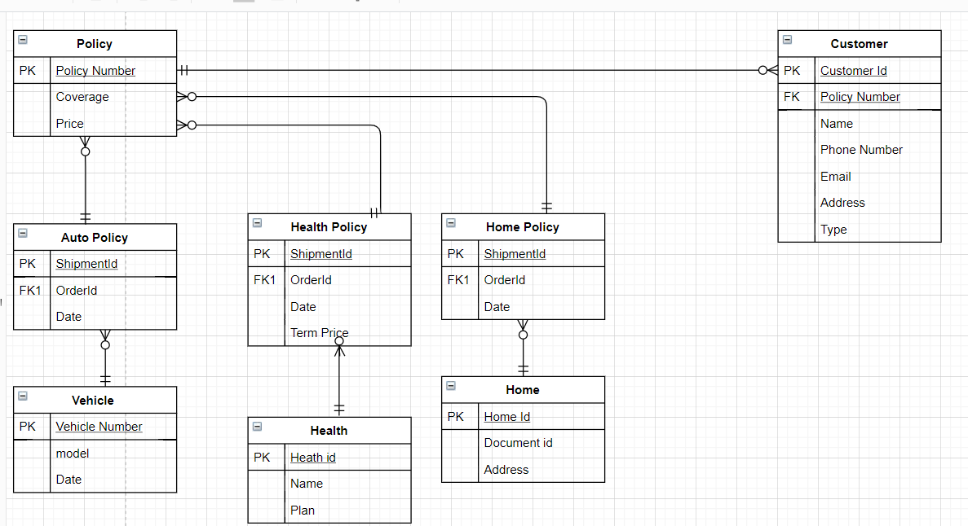
ER/Schema Diagram

Slide 5
Implementation Modules
Module | Concept used to implement the module | Module Finish Date
Database connectivity and Creation of table | Encapsulation, Database | Monday by 4:00 PM
Customer/Admin Login |  | Tuesday by 4:00PM
Back End Process development |  | Thursday by 4:00 PM

Slide 6

Thank You

